Slide 1
University of Basrah
Al-Zahraa Medical College
Ministry of higher Education and Scientific Research
Academic year 2021-2022
3rd year S 6
Fluid Balance
Session: 2
Lecture: 1
Date: 10/3/2022
Module staff:
Dr Sadeq Khalaf(module leader) Dr Jawad Ramadan
Dr Ihssan Mardan
Dr Miami Kadhum
Dr Nehaya Aluboody
Dr Rehab A. Jaafer
Dr Thura Kadhum
Dr Mohammed Yass
Dr Ahmed Bader
Dr Ilham Mohammed

Slide 2
University of Basrah
Al-Zahraa Medical College
Ministry of higher Education and Scientific Research
Learning objectives
1-Describe the main fluid compartments of the body
2-List the normal volumes of each fluid compartment in adults
3-Describe the electrolyte composition of each fluid compartment
4-Explain the processes by which electrolytes and water move between body fluid compartments
5-Explain the renal mechanisms for the regulation of extracellular fluid volume and composition

Slide 3
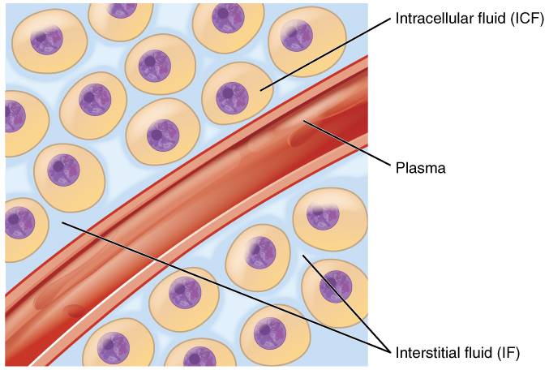
University of Basrah
Al-Zahraa Medical College
Ministry of higher Education and Scientific Research
Body fluid compartment
LO1
Intracellular fluid (ICF) compartment is the system that includes all fluid enclosed in cells by their plasma membranes.
Extracellular fluid (ECF) surrounds all cells in the body :
The plasma (fluid component of the blood)
The interstitial fluid (IF) that surrounds all cells not in the blood.

Slide 4
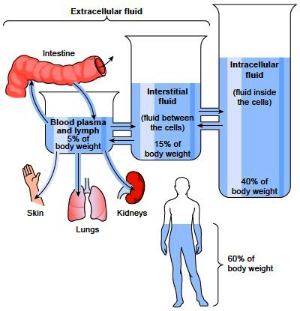
University of Basrah
Al-Zahraa Medical College
Ministry of higher Education and Scientific Research
The normal volumes of each fluid compartment in adults
LO1,2
1/3 of TBW
75% of ECF
25% of ECF
2/3 of TBW
TBW
Notes:
This percentage depends on age, gender, and degree of obesity (percentage of body fat). As a person grows older, the percentage of total fluid gradually decreases. This decrease is due in part to the fact that aging is usually associated with an increased percentage of the body weight being fat, which decreases the percentage of water in the body. In women, total body water averages about (50- 55) % of the body weight because normally there are greater percentage of body fat compared with men. In premature and newborn babies, the total body water ranges from (70- 75) % of body weight.

Slide 5
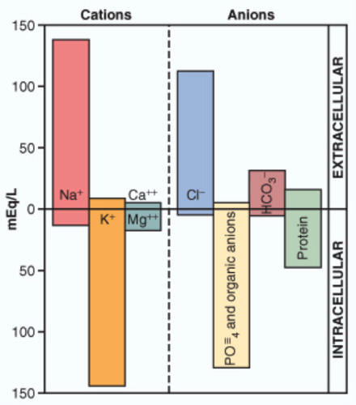
University of Basrah
Al-Zahraa Medical College
Ministry of higher Education and Scientific Research
LO3
Most body fluids are neutral in charge.
Thus, cations and anions are balanced in fluids.
Distribution of fluid between intracellular and extracellular compartments is determined by the concentration of osmotically active substance which are :
Electrolyte :
ECF: Na⁺ , Cl –
ICF : K⁺ ,PO4 –
Non electrolyte :
Phospholipid , cholesterol ,urea,
bilirubin ,uric acid .
Normal plasma osmolarity 285-295 mOsm/L

Slide 6
University of Basrah
Al-Zahraa Medical College
Ministry of higher Education and Scientific Research
Movement of fluid between compartments
LO4
Fluid is separated into compartments by semipermeable membranes. The membranes are highly permeable to water.
Water moves between compartments following osmotic gradients (Osmosis)
A change in the concentration of solute or water will cause water to shift between compartments.

Slide 7
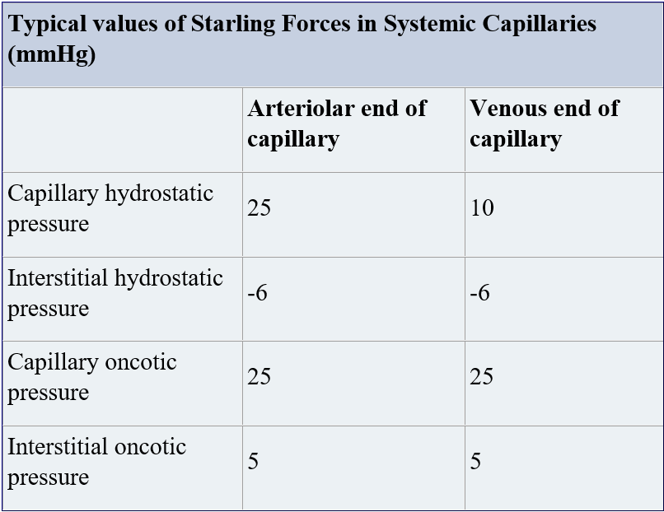
University of Basrah
Al-Zahraa Medical College
Ministry of higher Education and Scientific Research
Movement of fluid between compartments
LO4

Slide 8
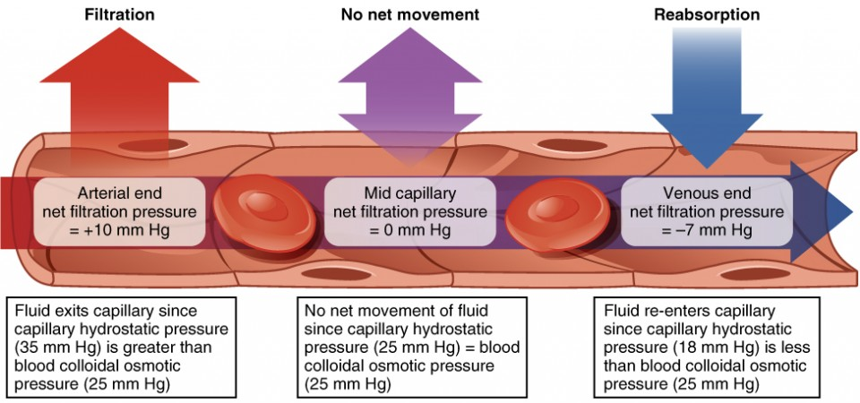
University of Basrah
Al-Zahraa Medical College
Ministry of higher Education and Scientific Research
LO4
Fluid Movement between Compartments
Notes:
Hydrostatic pressure, the force exerted by a fluid against a wall, causes movement of fluid between compartments. The hydrostatic pressure of blood is the pressure exerted by blood against the walls of the blood vessels by the pumping action of the heart. In capillaries, hydrostatic pressure (also known as capillary blood pressure) is higher than the opposing “colloid osmotic pressure” in blood—a “constant” pressure primarily produced by circulating albumin—at the arteriolar end of the capillary. This pressure forces plasma and nutrients out of the capillaries and into surrounding tissues. Fluid and the cellular wastes in the tissues enter the capillaries at the venule end, where the hydrostatic pressure is less than the osmotic pressure in the vessel. Filtration pressure squeezes fluid from the plasma in the blood to the IF surrounding the tissue cells. The surplus fluid in the interstitial space that is not returned directly back to the capillaries is drained from tissues by the lymphatic system, and then re-enters the vascular system at the subclavian veins.
The net driving pressure is outward at the arteriolar end and inward at the venous end of the capillary. This change in net driving pressure is due to the decrease in the capillary hydrostatic pressure along the length of the capillary.

Slide 9
University of Basrah
Al-Zahraa Medical College
Ministry of higher Education and Scientific Research
Movement of fluid between compartments
LO4
Two processes are responsible for the movement of fluid across membranes:
Ion movement across a membrane .
Osmosis: Water is drawn across a membrane toward a region where there is a higher solute concentration.

Slide 10
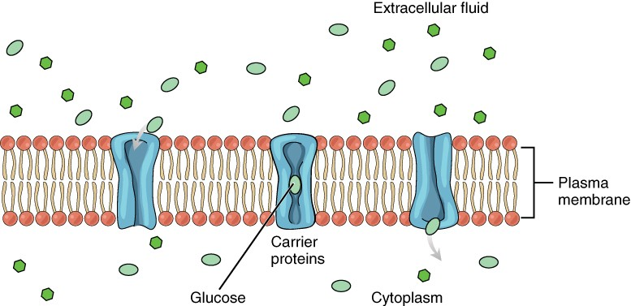
University of Basrah
Al-Zahraa Medical College
Ministry of higher Education and Scientific Research
Solute Movement between Compartments
LO4
1-Passive transport
eg. Glucose
2-active transport
Sodium – potassium ATPase pump
Glucose molecules use facilitated diffusion to move down a concentration gradient through the carrier protein channels in the membrane

Slide 11
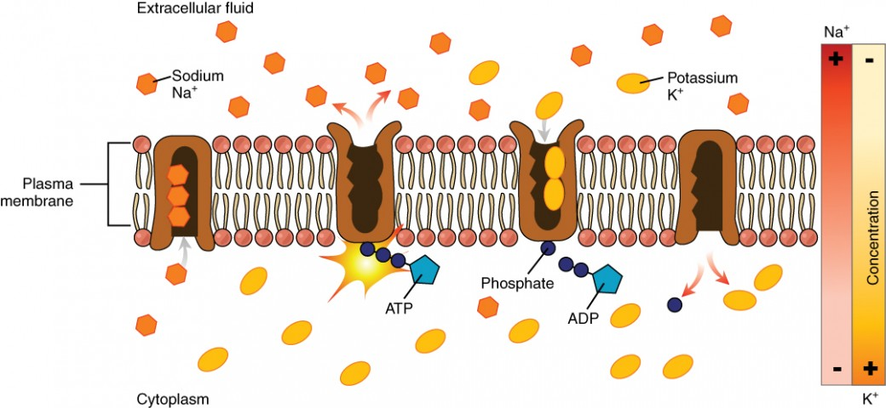
University of Basrah
Al-Zahraa Medical College
Ministry of higher Education and Scientific Research
Sodium – potassium ATPase pump
LO4

Slide 12
University of Basrah
Al-Zahraa Medical College
Ministry of higher Education and Scientific Research
LO4
Sodium (Na⁺) ions and chloride (Cl–) ions are concentrated in the ECF of the body, whereas potassium (K⁺) ions are concentrated inside cells. Although sodium and potassium can “leak” through “pores” into and out of cells, respectively, the high levels of potassium and low levels of sodium in the ICF are maintained by sodium-potassium pumps in the cell membranes. These pumps use the energy supplied by ATP to pump sodium out of the cell and potassium into the cell.

Slide 13
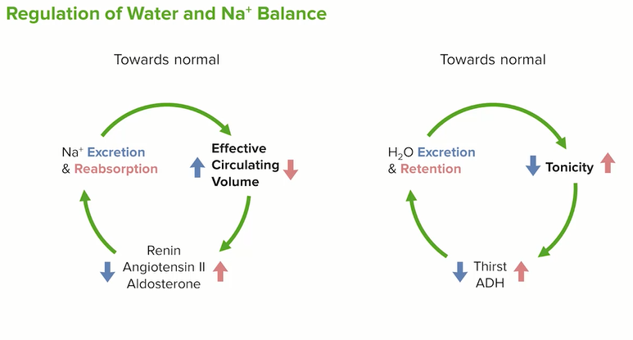
University of Basrah
Al-Zahraa Medical College
Ministry of higher Education and Scientific Research
LO4

Slide 14
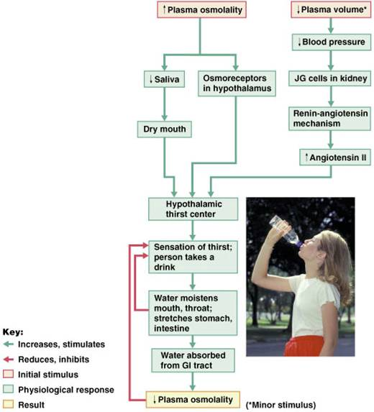
University of Basrah
Al-Zahraa Medical College
Ministry of higher Education and Scientific Research
Thirst mechanism
(LO5)
1- When the sodium concentration increases only about 2 mEq/L above normal, the thirst mechanism is activated, causing a desire to drink water. This is called the threshold for drinking.
2- Decline in plasma volume of 10%–15%
Notes:
The kidneys must continually excrete at least some fluid, even in a dehydrated person, to rid the body of excess solutes that are ingested or produced by metabolism. Water is also lost by evaporation from the lungs and the gastrointestinal tract and by evaporation and sweating from the skin. Therefore, there is always a tendency for dehydration, with resultant increased extracellular fluid sodium concentration and osmolarity.
Feedback signals that inhibit the thirst centers include:
Moistening of the mucosa of the mouth and throat
Activation of stomach and intestinal stretch receptors

Slide 15
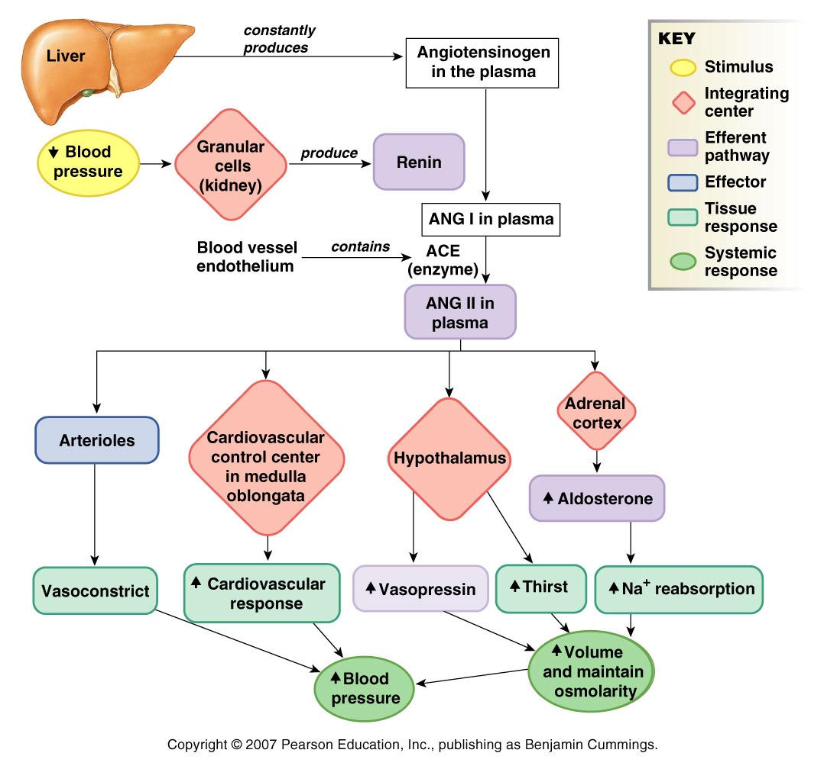
University of Basrah
Al-Zahraa Medical College
Ministry of higher Education and Scientific Research
(LO4 &5)
The renin-angiotensin-aldosterone pathway- (RAAS)

Slide 16
University of Basrah
Al-Zahraa Medical College
Ministry of higher Education and Scientific Research
Renal mechanisms for the regulation of extracellular fluid volume and composition
LO5
By controlling their reabsorption of different substances, the kidneys regulate excretion of solutes independently of one another, a capability that is essential for precise control of the body fluid composition

Slide 17
University of Basrah
Al-Zahraa Medical College
Ministry of higher Education and Scientific Research
Renal mechanisms for the regulation of extracellular fluid volume and composition
LO5
Proximal convoluted tubule
Active reabsorption of solute and osmosis of water
Loop of Henle
The descending limb of loop of Henle is permeable to water but ascending is not. In thick ascending segment Na+, K+ and Clˉ are reabsorbed to ISF
Distal convoluted tubule
Function in same manner as thick segment of ascending limb of loop of Henle
Collecting duct
At end of PCT about 60-70% of filtered water and solutes will be removed from fluid when treat this position
Counter current mechanism to concentrate the urine
about 5% of water is removed in distal tubule.
Vasopressin dependent water reabsorption

Slide 18
University of Basrah
Al-Zahraa Medical College
Ministry of higher Education and Scientific Research
LO5
Counter current mechanism
A special mechanism for concentrating the urine it is one of the most important physiological phenomena in all of nature. it is depend on the anatomical arrangement of loop of Henle and vasa recta in renal medulla
Counter current mechanisms include :-
1- Counter-current multiplier takes place in the Henle's loop
an active process that establishes the hypertonicity of medullary interstetium
2- Counter-current exchanger takes place in the 'vasa recta'.
a purely passive process that helps maintain the medullary interstetium tonicity.
Notes:
The active reabsorption and shifts of Na+ and cl- from tubular fluid in ascending limb of loop of Henle to interstetium medullary interstetium hypertonicity
Counter-current multiplier
In descending limb water will be reabsorbed from tubular fluid progressively. So, as fluid move down, to descending limb become more hypertonic and as it moves up to the ascending limbs it will become more hypotonic and the medullary interstetium become hypertonic from base to tip of pyramids

Slide 19
University of Basrah
Al-Zahraa Medical College
Ministry of higher Education and Scientific Research
LO5
Counter current mechanism
The passive properties of the vasa recta are the same as for other capillaries:
They are freely permeable to small solutes and water.
Blood flow through the vasa recta is slow, and solutes and water can move in and out, allowing for efficient countercurrent exchange.
Blood entering the descending limb of vasa recta has an osmolarity of 300 mOsm/L. At the bend of the vasa recta, the blood has an osmolarity equal to that of interstitial fluid at the tip of the papilla, 1200 mOsm/L.
Notes:
*The hypertonic medullary interstetium can be washed out if there is good blood supply, but actually the blood flow to medulla ↓progressively from cortico medullary junction to papilla.
*Also by function of vasa recta the hyper-tonicity of medulla is maintained
The descending limb of these vessels secrete H2O to interstetium, H2O →ascending limb of vessels and this H2O will be taken up from medulla to circulation.
In ascending limb of vessels Na+, cl- and urea will diffuse out to interstetium then to descending limb .
Urea will also act to hyper tonicity of inner medulla via replace any solute that is carried away by blood flow.

Slide 20
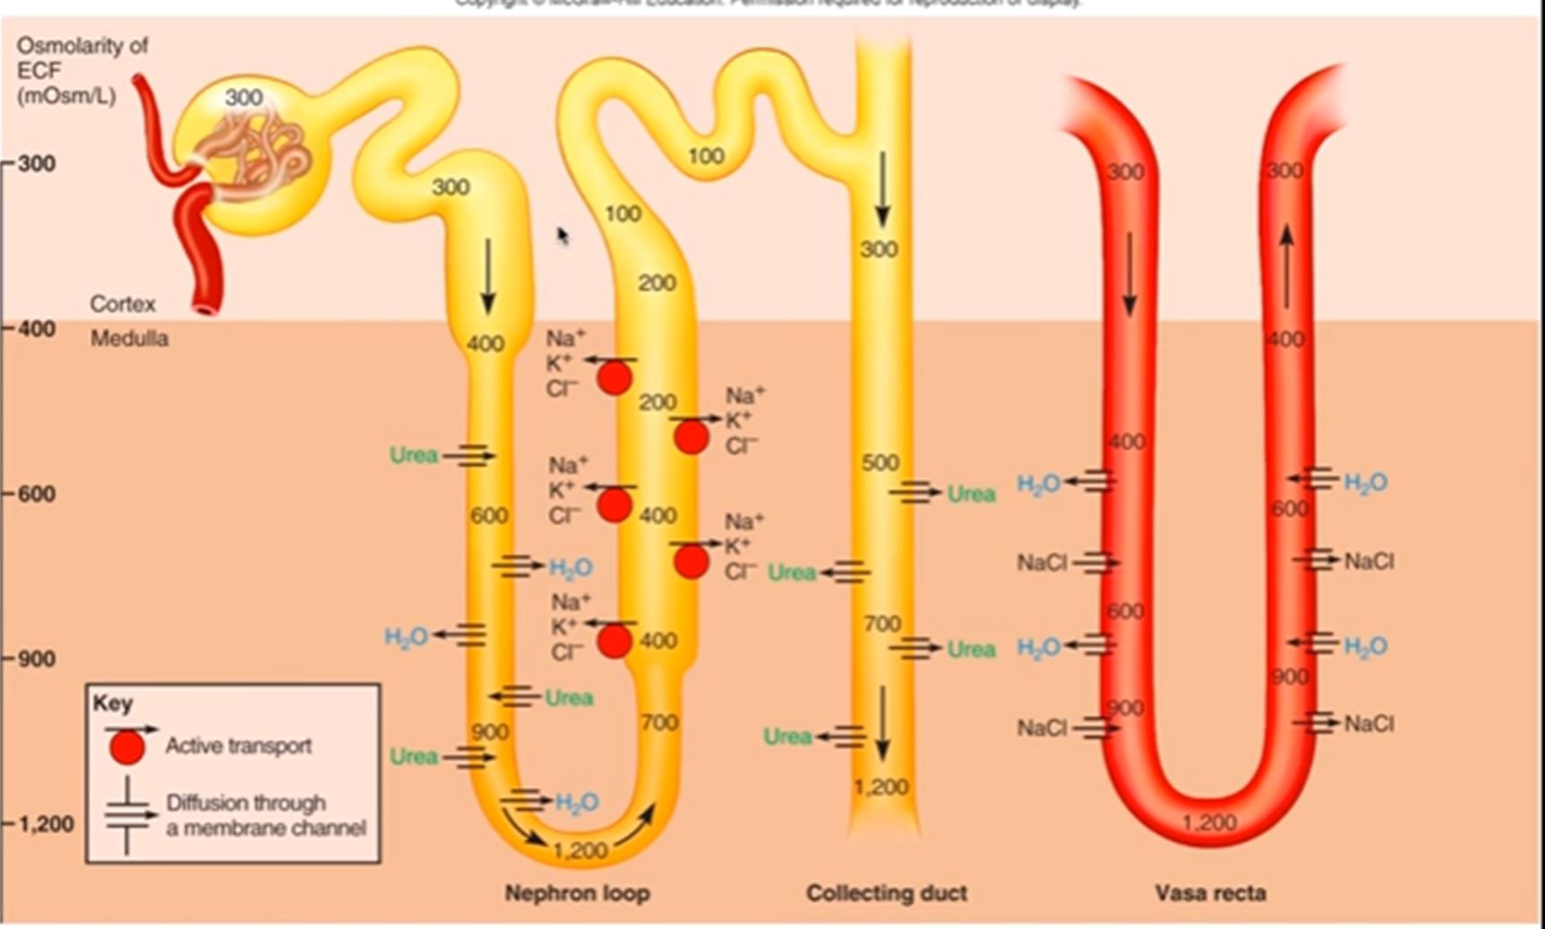
University of Basrah
Al-Zahraa Medical College
Ministry of higher Education and Scientific Research
LO5
Counter current mechanism

Slide 21
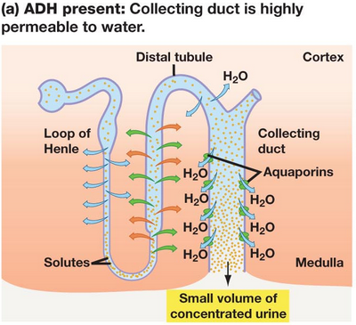
University of Basrah
Al-Zahraa Medical College
Ministry of higher Education and Scientific Research
Vasopressin dependent water reabsorption
LO5
in this condition of maximum antidiuresis the urine osmolality may reach 1400 mosm /l
(5 times plasma osmolality) and about 99.7% of filtered water will be reabsorbed and only 0.3% will be excreted in urine.

Slide 22
University of Basrah
Al-Zahraa Medical College
Ministry of higher Education and Scientific Research
Vasopressin dependent water reabsorption
LO5
B- When ADH is absent (as in diabetus insipidus)
The collecting duct epithelium will become relatively impermeable to water, and filtrate will remain hypotonic and only about 2% of filtered water will reabsorbed along with salts reabsorption
so in absence of ADH the urine osmolality → 30 mosm/l and about 13% of filtered water may be lost in urine and the urine volume be more than 20 L/day.

Slide 23
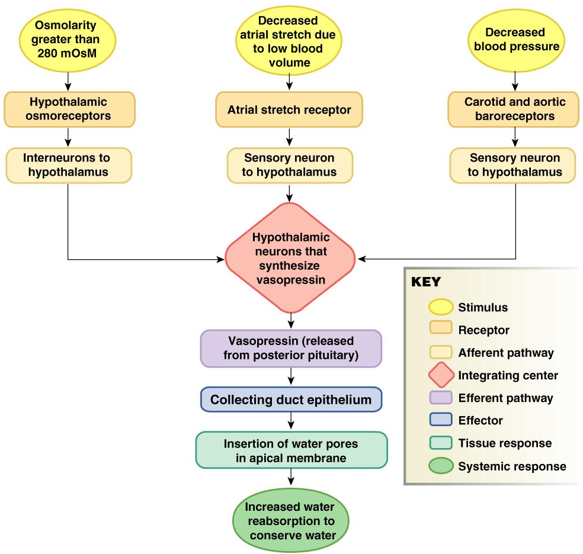
University of Basrah
Al-Zahraa Medical College
Ministry of higher Education and Scientific Research
Vasopressin dependent water reabsorption
LO5
Three stimuli control vasopressin but the most potent is blood osmolarity above 280mOsM. The higher the osmolarity, the more vasopressin released by posterior pituitary. Osmoreceptors also trigger thrist centers in hypothalamus
Notes:
-Some substances such as alcohol which directly inhibit the pituitary gland and decease the ADH level.
-Pain, emotion , exercise and anesthesia all are stimulate the ADH secretion from the pituitary gland lead to decrease the urine volume.

Slide 24
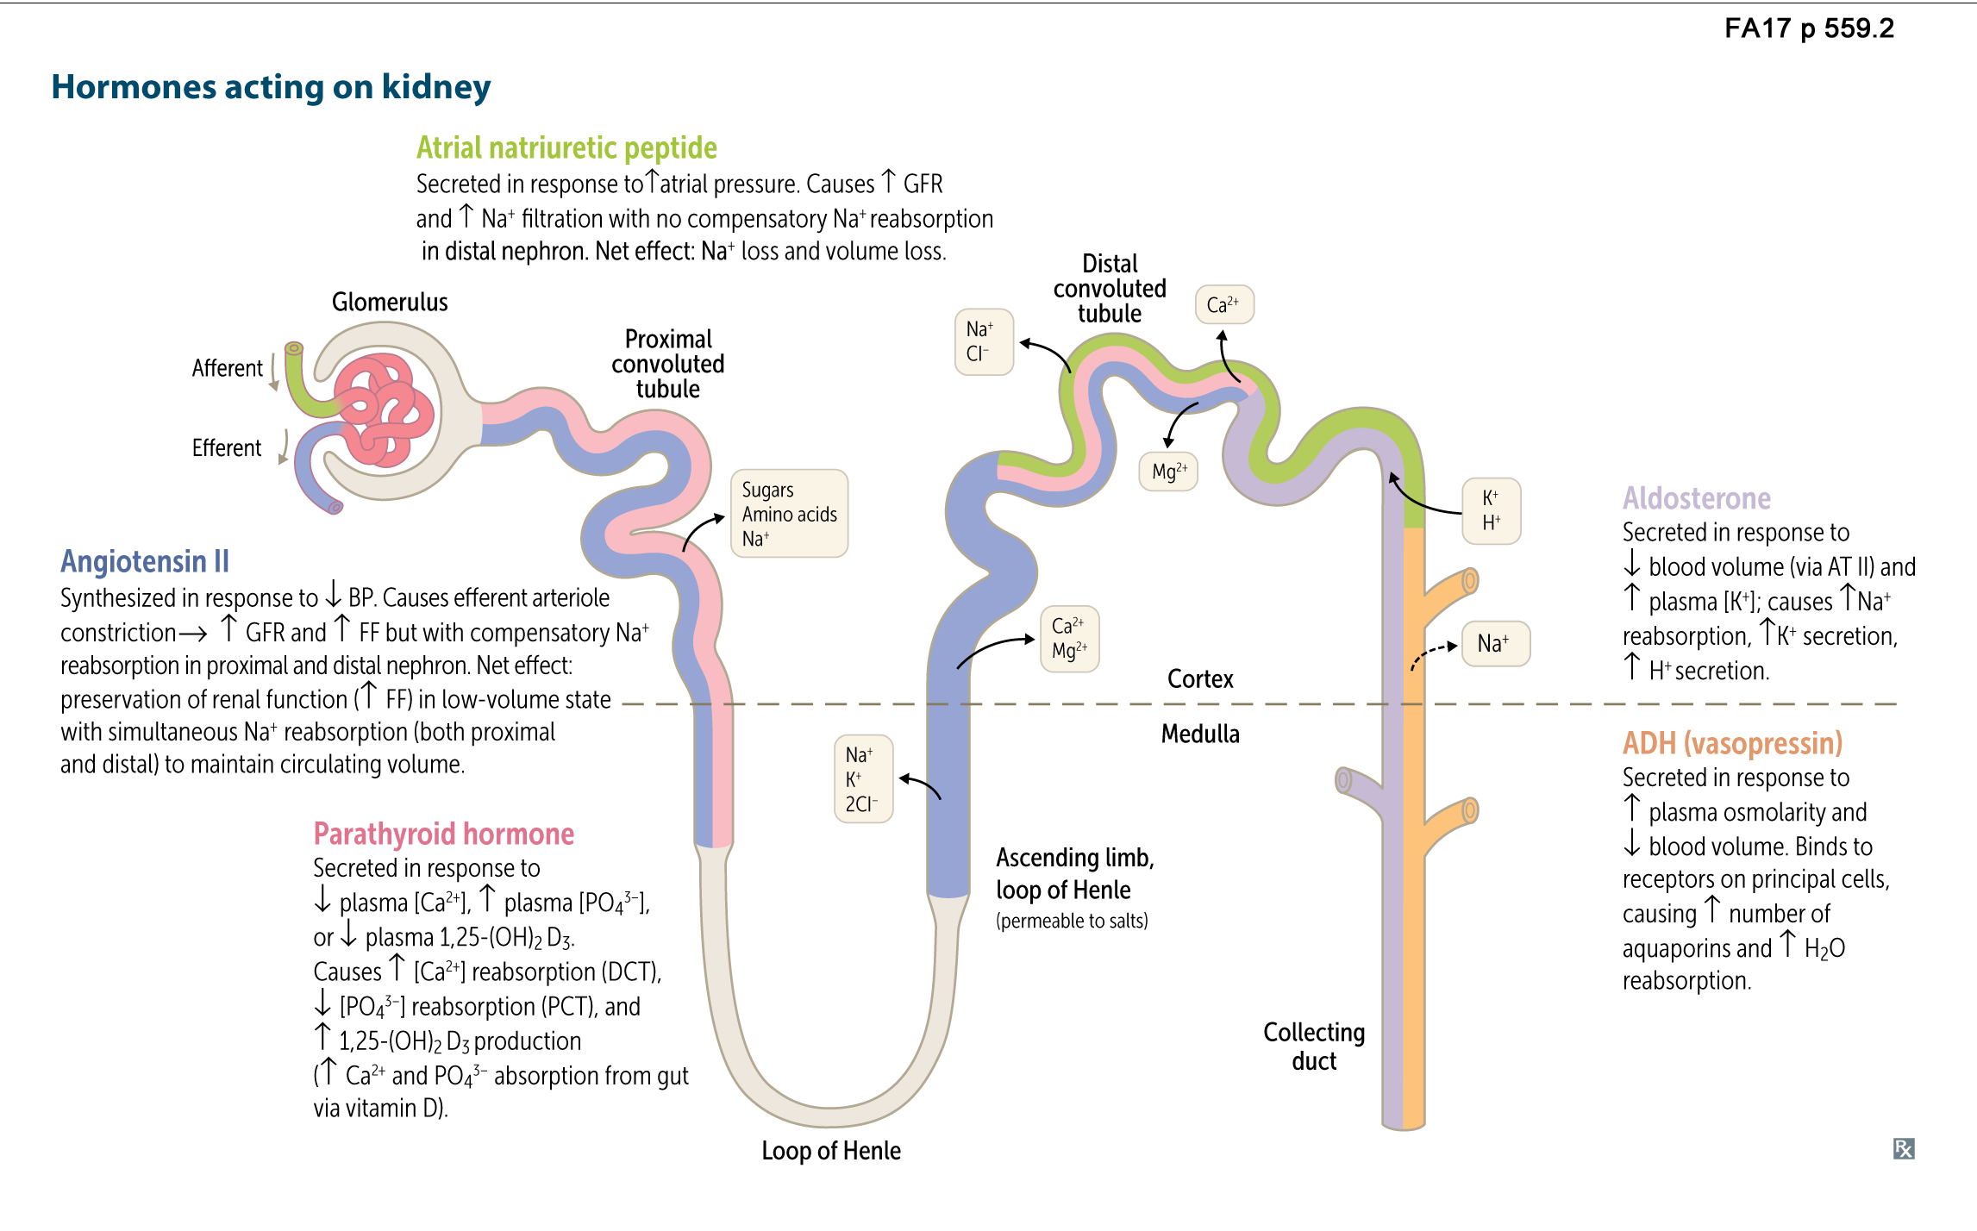
University of Basrah
Al-Zahraa Medical College
Ministry of higher Education and Scientific Research
Hormones acting on kidney
LO5

